Slide 1

CIS 480 Capstone Project
Jack Hopkins, Brittney Galderise

Slide 2
Hello!
Welcome to our presentation.
We are Jack Hopkins and Brittney Galderise, and this slideshow will go over our CIS 480 Project.

Slide 3

Our web app is called:

Slide 4
What need is this website filling?
It fills the role for a small business e-commerce website
It allows the business to reach out and have a presence online.
Keeps track of inventory changes

Slide 5



Register
Allows for a user account to be created
Login to an existing account
Password security rules
View Stock
Collects data from database and displays it
Search function
*Add, edit, and delete functionality
Shop
Users can search products to see info
Displays products
Details company for customers

Slide 6
Site Overview
The site has multiple pages with navigation. Home, Store, Login, Register, Contact, About, Inventory
The homepage gives an overview of the site
Store allows customers to view products, inventory does the same except you need to register to have access
Login and register are for creating and login into the site with an account
Contact describes how to contact the store
About details information about the store

Slide 7

What is the website’s purpose?
The site is for a small gaming store called Moonlit Games
The store is going into e-commerce and would like a website that can interact with customers
Customers would use it to see what products are in stock
Users can register to get access to the inventory and search functionality

Slide 8

Target Audience
The main target for the site is for their customers or other people interested in buying games.
Audience may be around 16-30s in age range
Mostly males
Average income

Slide 9
Risks and weaknesses
Risks
Many other gaming sites exist, developing one in a crowded market
Must find way to stand out
Maintenance vs. Profit costs
Weaknesses
Limited inventory
Not a household brand name
Attracting new customers

Slide 10
Development Process
1st week: Planning
2nd week: Webpage navigation and login page
3rd week: Search function, register and login, website design almost finished
4th week: Clean up the website design, add, edit, and delete features
5th week: Final touches

Slide 11
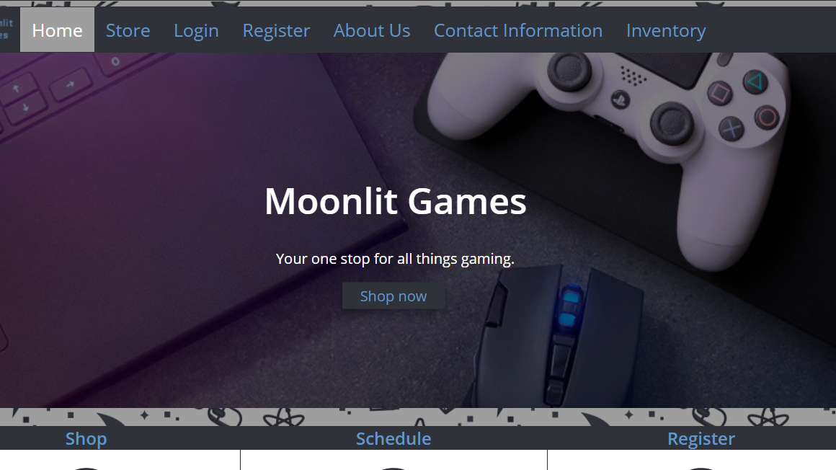
Home

Slide 12
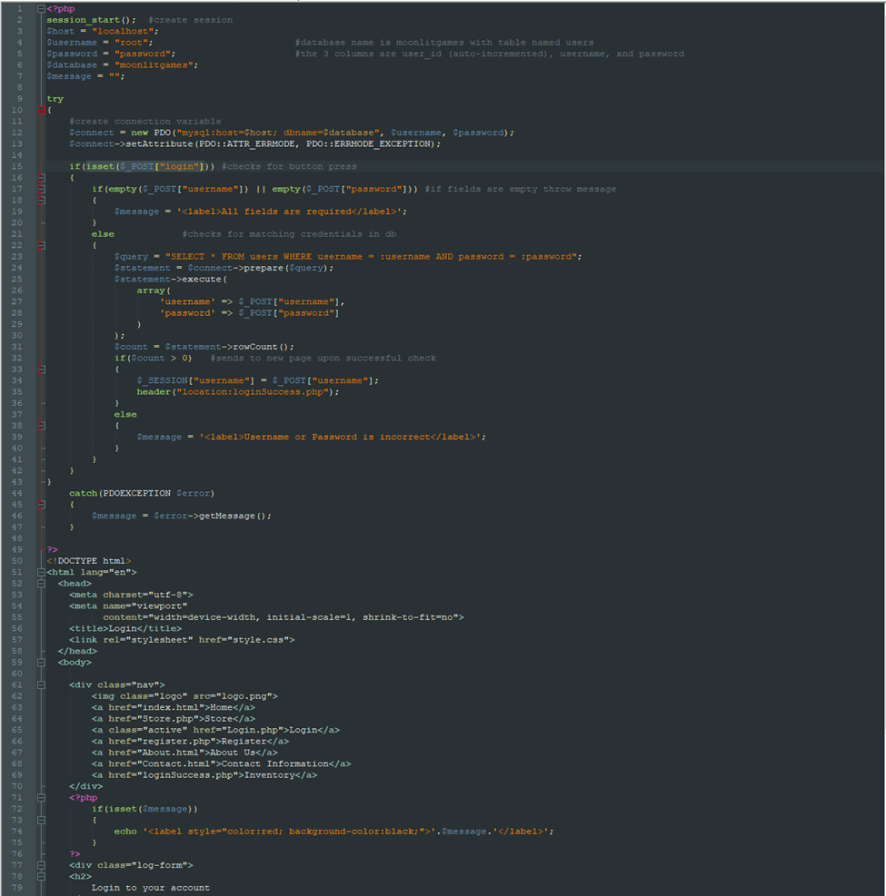
Login php code

Slide 13
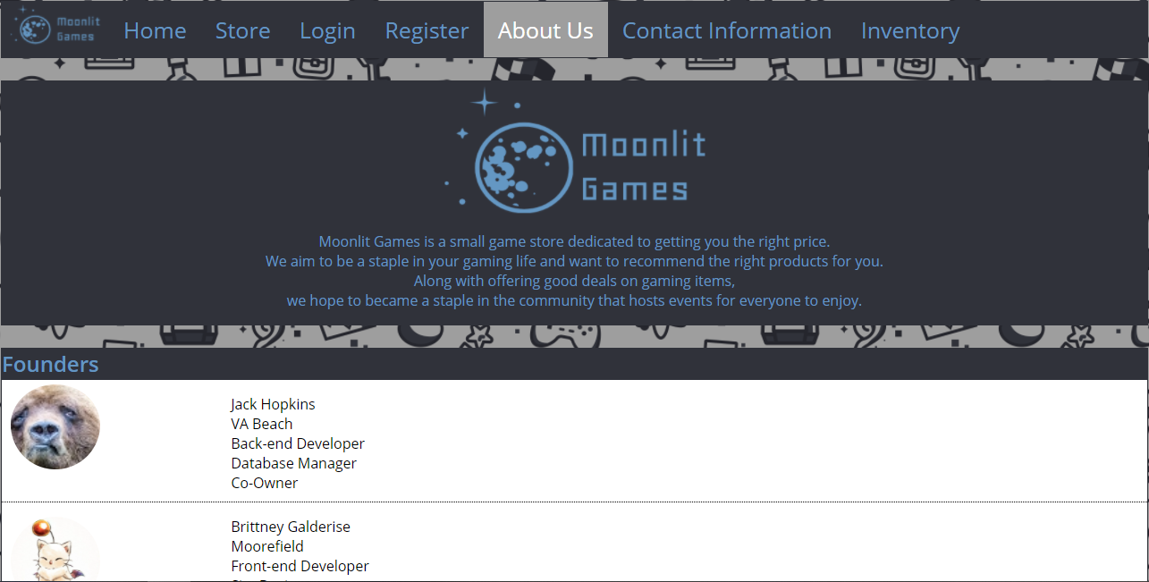
About Us

Slide 14
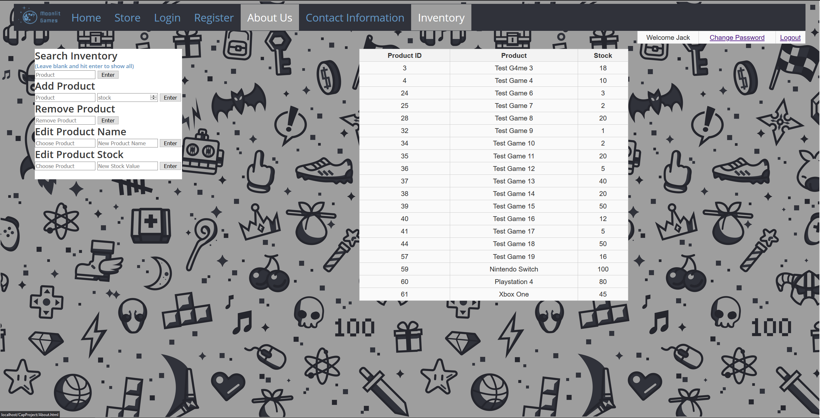
Inventory

Slide 15
The End
Thank you!

